Slide 1
Slide 1
Demand Forecast
Forecasting market demand for new ice-cream brand using historical sales data set
Disclaimer: The data presented in this PPT has been altered and few hypothetical assumptions have been considered,
the data presented has been gathered by market survey and supplier survey.

Slide 2
Slide 2
Assumptions
Economic conditions and consumer preferences remain stable.
Marketing efforts and distribution channels remain the same.
Seasonal variations in demand follow the same pattern as the current year.
We will assume a 2.15% annual growth rate in demand due to increased popularity and marketing efforts.
Stable market and equilibrium in the market.
Stick ice cream will need another machine as the demand for cup and cone come under the top 3 and cone and cup are done in one machine then we'll opt for cone and cup.
2

Slide 3

Slide 10
Monthly Demand forecast
The line chart shows the monthly forecasted demand of over all ice-cream including all the flavors.
The orange line shows the forecasted demand while the blue line shows the current sales.
The formula used to calculate the forecasted demand is: Current Sales * (1+2.15%).
2.15 is the expected growth rate due to increased popularity
3

Slide 4
Slide 10
Forecasted Demand by Flavors
The stacked column chart shows the monthly forecasted demand by different flavors.
The formula used to calculate the forecasted demand is: Current Sales * (1+2.15%).
Each colored stacked column shows expected forecasted monthly demand by different flavors.
4

Slide 5
Slide 2
Six Sigma DMADV
The DMADV, Define-Measure-Analyze-Design-Verify process will be used to apply the PULL strategy to beat the current market competition.
The five phase is customer driven.
Enhances customer satisfaction.
Helps to increase profits.
Reduction in defects.
6

Slide 6
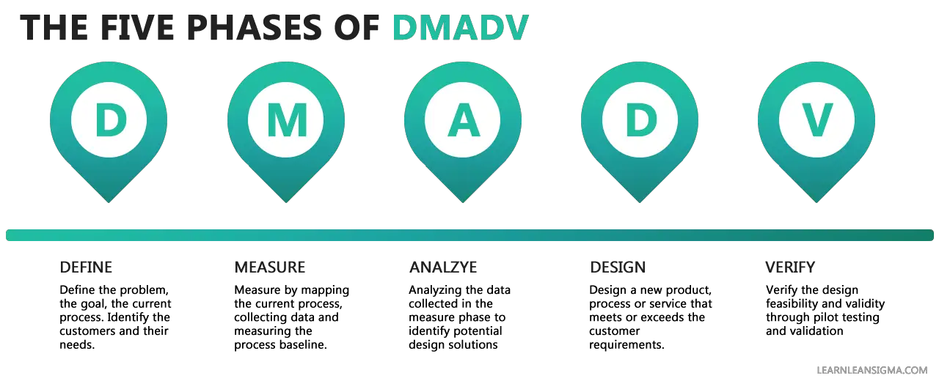
Slide 2
Strategy Application
7

Slide 7
Slide 3
Difference Between Forecasted And Current Market Share
8

Slide 8
Slide 3
Forecasted Market Share By Product Type
The pie chart shows the expected market share of each product type during the year.
Stick is expected to capture most of the market.
With a difference of 5% Cup is expected to capture 23% of the market.
Cone and Tub are expected to capture equal amount of market share.
Followed by Brick capturing 12% of the market.
9

Slide 9
Slide 3
Cost Structure
80%
2%
Raw Materials
Equipment
80% of company’s total cost has been contributed towards the purchase of Raw Materials.
2% of company’s total cost has been contributed towards the purchase of Equipment.
11%
0.12%
Manpower
Transport
9% of company’s total cost has been contributed towards the employment of Manpower.
0.12% of company’s total cost has been contributed towards the Transportation.
7%
Marketing
7% of company’s total cost has been contributed towards the purchase of Marketing.
10

Slide 10
Slide 2
Cost Model
11

Slide 11
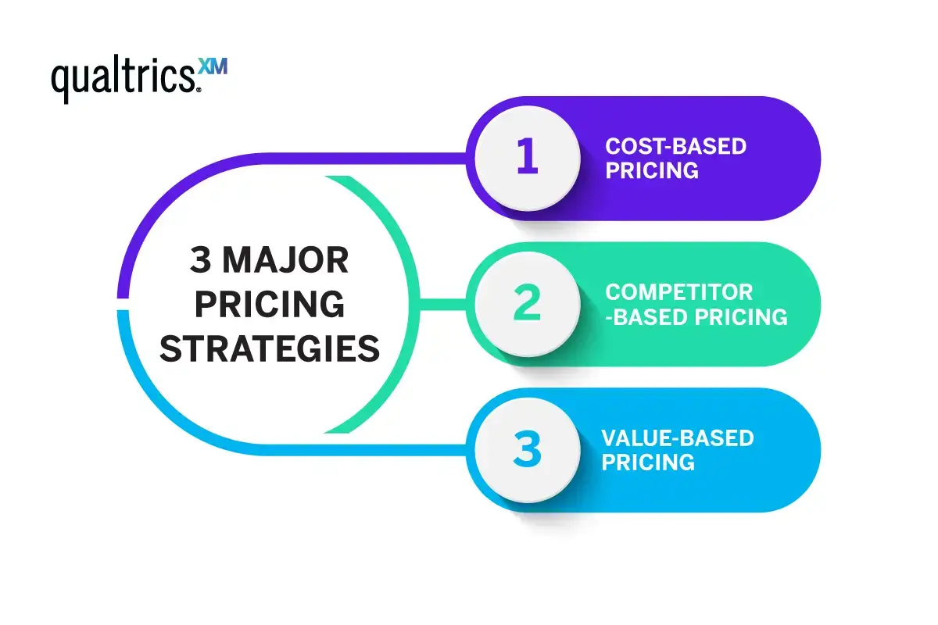
Slide 2
Pricing Strategy
12

Slide 12
Slide 2
Pricing Model

Slide 13
Slide 2
Pricing Strategy
Thoroughly analyzing the production costs, including ingredients, labor, and overhead, is important in order to set a profitable price point.
Cost plus pricing strategy should be the most effective for a new brand to exist in the market. The cost plus pricing strategy is a simple pricing method to reach the break even point in a short period of time.
By selling 64,000 units of cone we can achieve the break-even point for cone, and by selling 96000 units of cup we can achieve the break-even point.
14

Slide 14
Slide 2
Optimization Strategies
To increase margins and efficiency or if things go south, the optimization strategy using the 6 sigma model can be a good option to be considered.
Supplier negotiations, alternative ingredients, waste reduction using FIFO to utilize the ingredients are use before expiration and local sourcing.
Leasing vs buying to reduce upfront costs, energy efficient technologies and optimum utilization of the equipments.
Optimized routes and 3LP third party logistics to enhance the distribution channel.
Digital marketing and targeted promotions.
Performance based incentive.
14

Slide 15
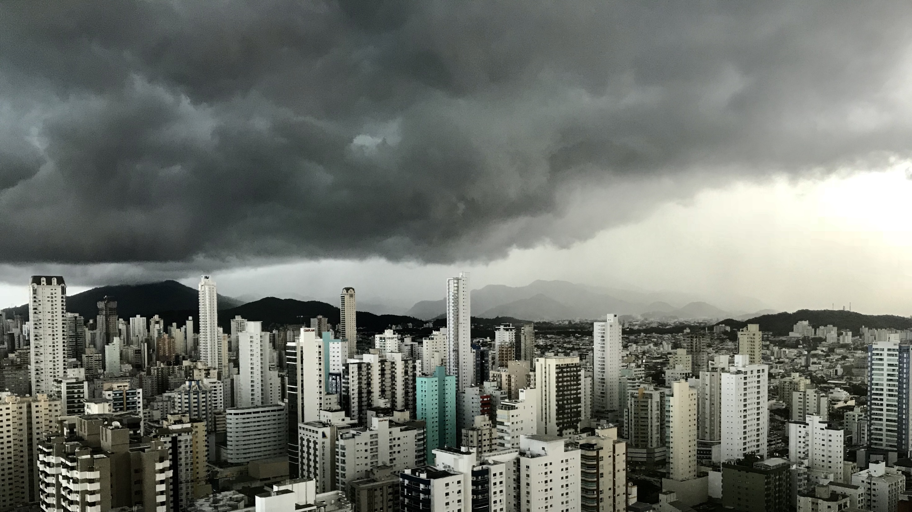
Slide 11
THANK YOU

